Slide 1
HASHING
DATA STRUCTURES

Slide 2
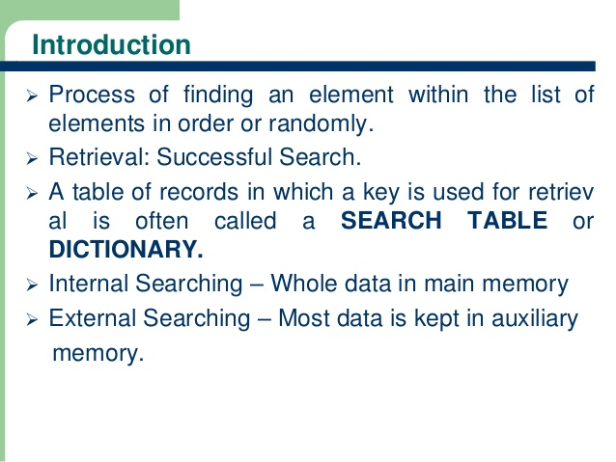

Slide 3
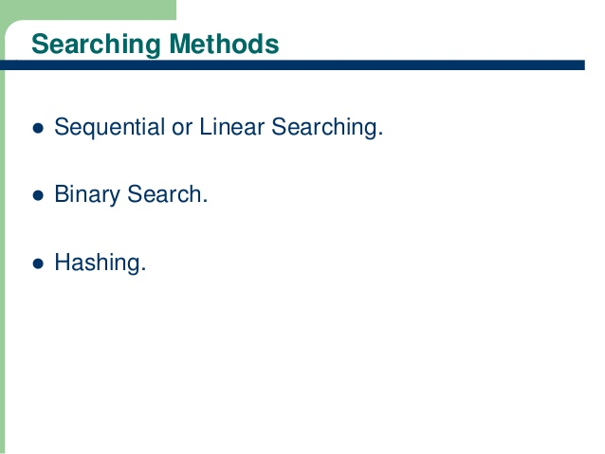

Slide 4
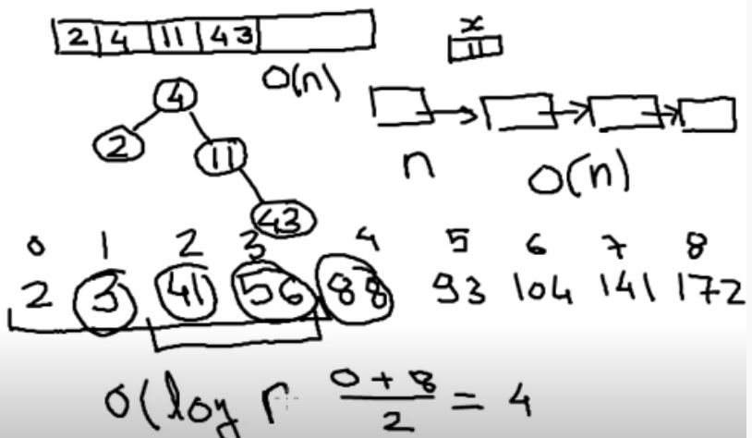
Searching techniques

Slide 5
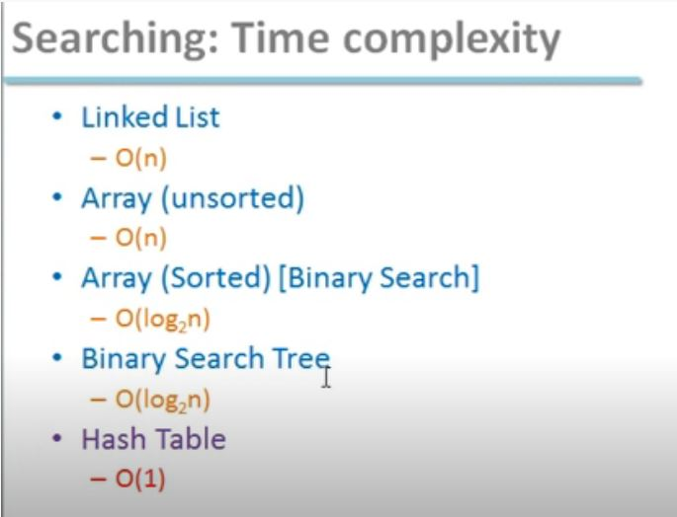

Slide 6
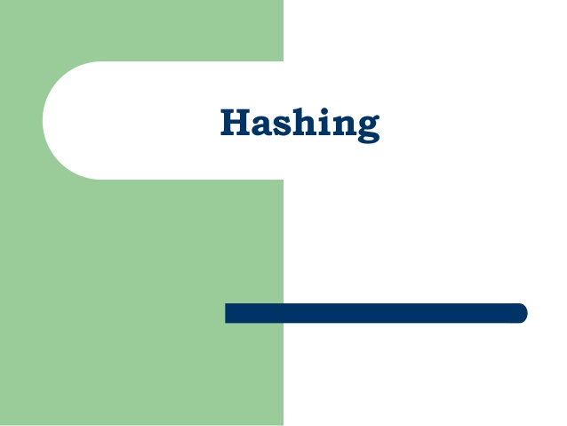

Slide 7
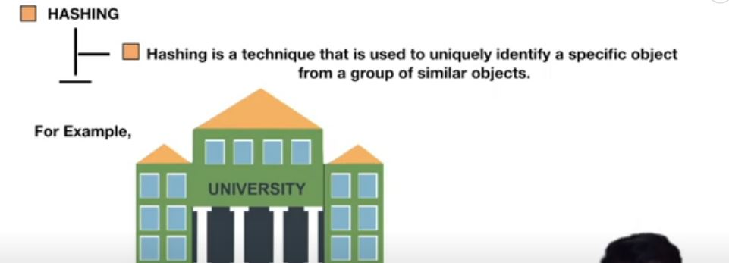
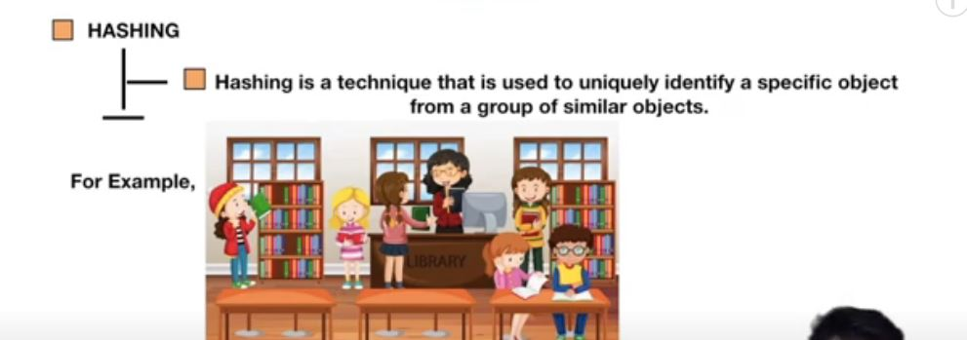
Hashing ?

Slide 8

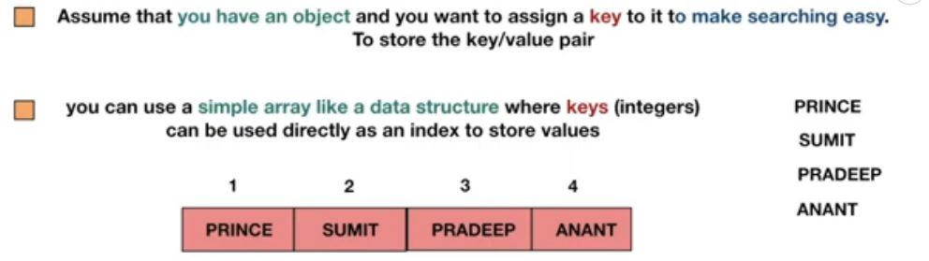

Hashing cont..

Slide 9
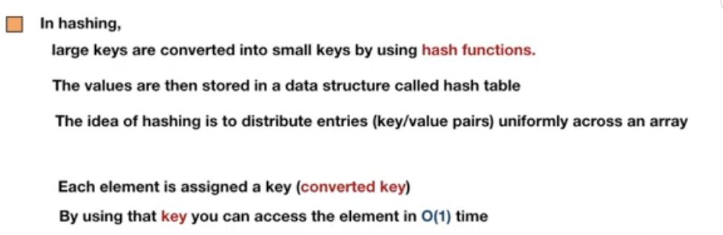

Hashing cont..

Slide 10
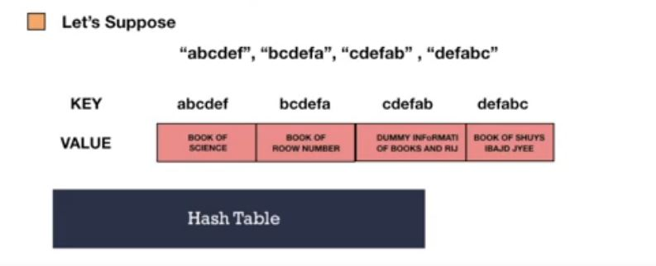
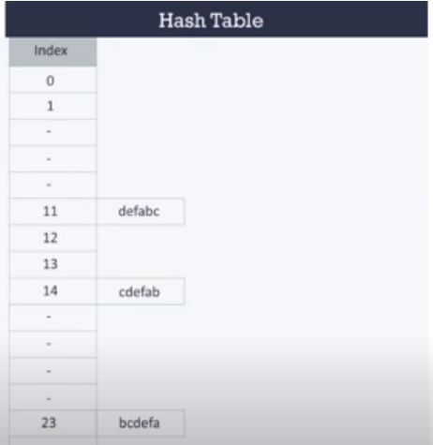
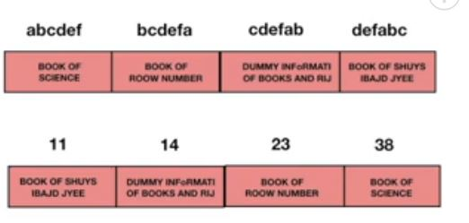
Hash table

Slide 11
Example

Slide 12
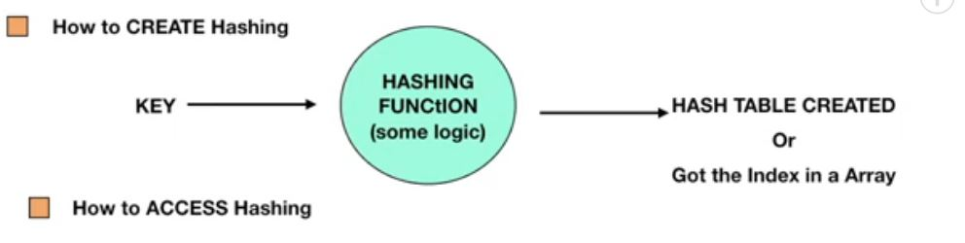
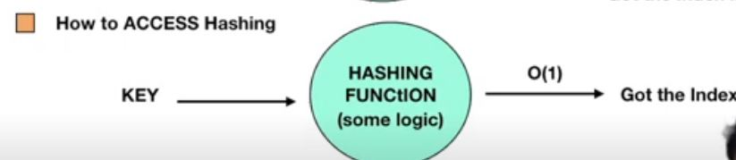

Creating hashing

Slide 13
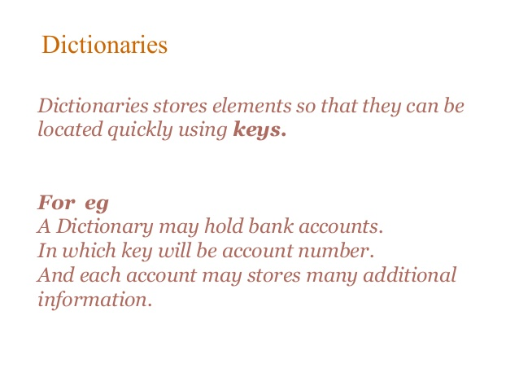
By: Hira Farman

Slide 14
HOW TO IMPLEMENT A DICTIONARY

Slide 15
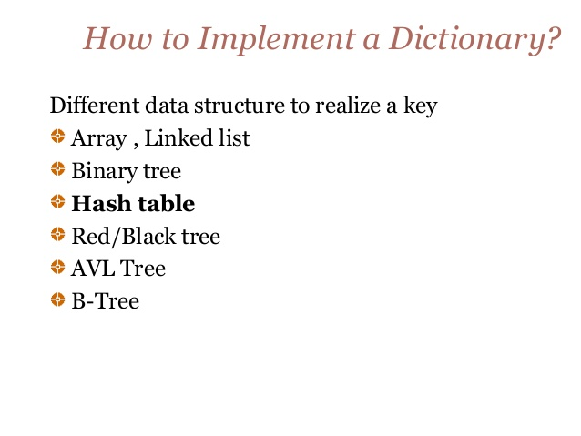

Slide 16
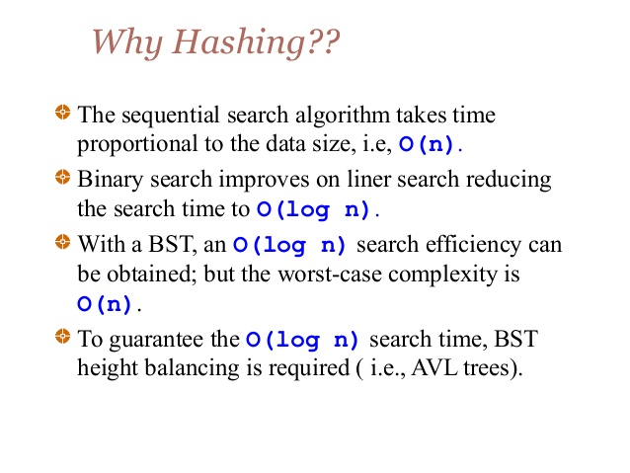

Slide 17
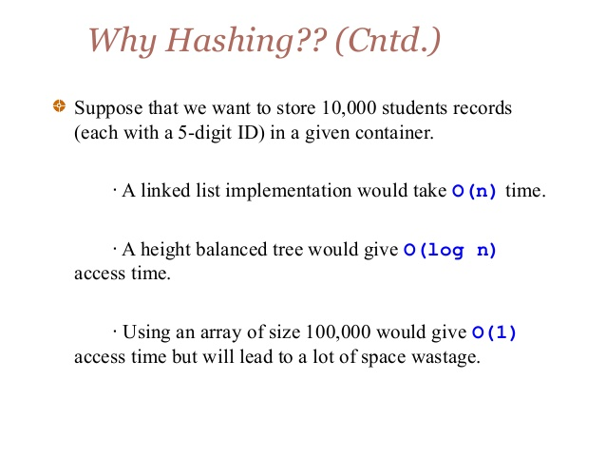
According to research

Slide 18
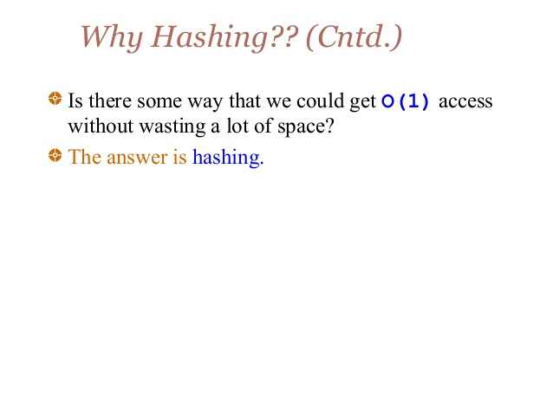

Slide 19


WHAT IS HASHING?

Slide 20
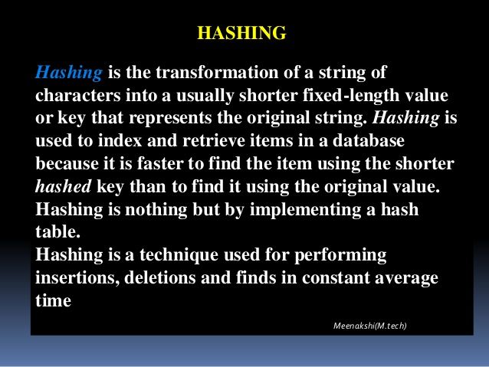

Slide 21
HASHING:
Hashing is the concept that order is determined by some function of the value of the element to be stored.
Order is unimportant
  More precisely, the location within the collection is determined by some function of the value of the element to be stored

Slide 22
HASHING:
In hashing, elements are stored in a hash table with their location in the table determined by a hashing function .
Each location in the hash table is called a cell or a bucket.

Slide 23
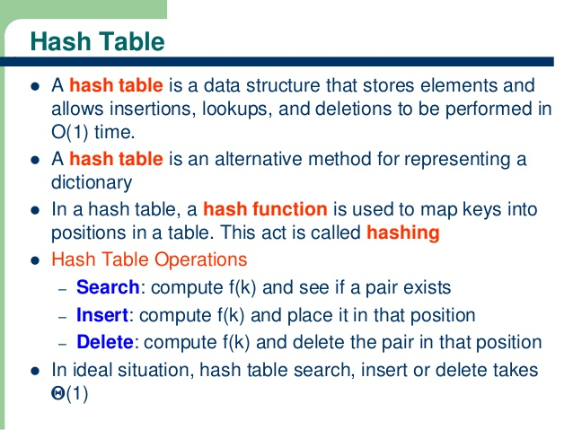

Slide 24
HASH TABLE OPERATION:
Search
Insert
Delete

Slide 25
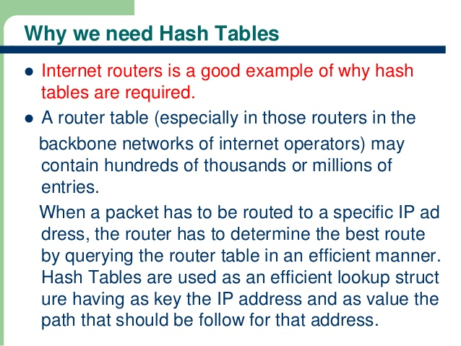

Slide 26
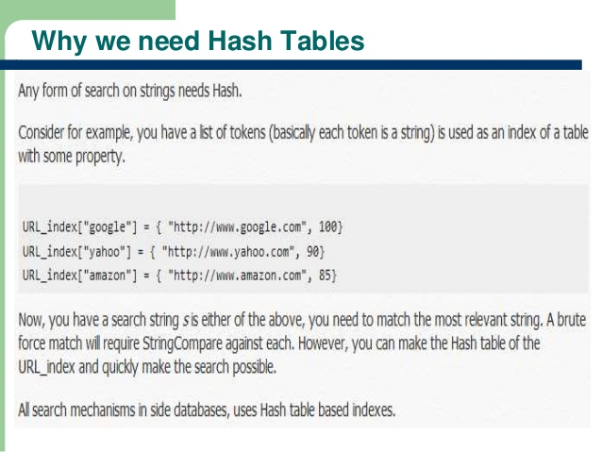

Slide 27
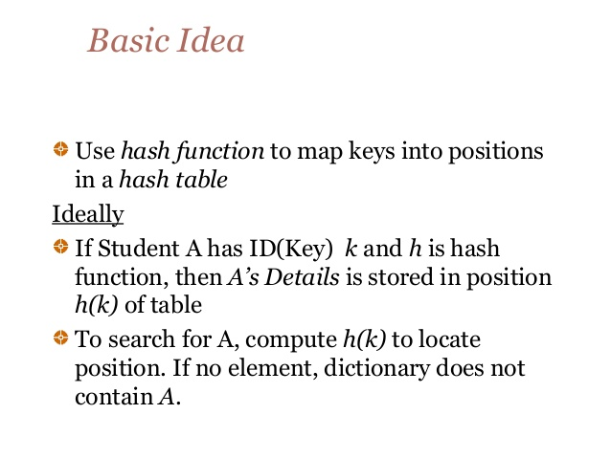

Slide 28
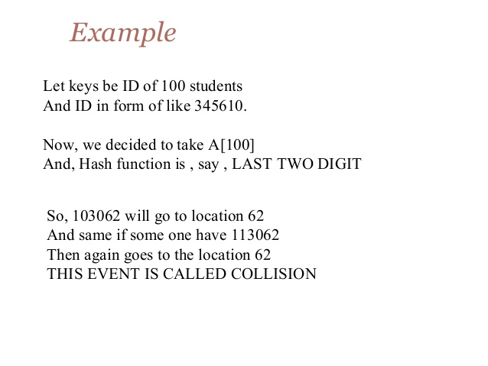

Slide 29
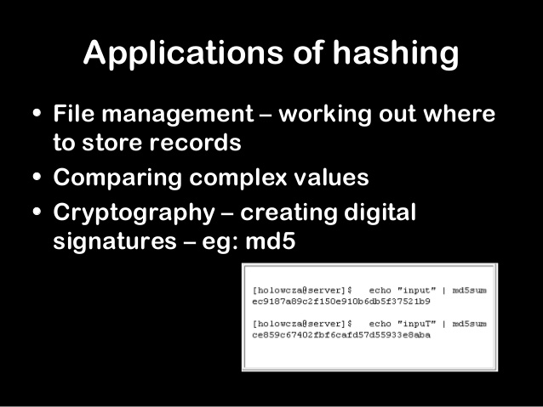

Slide 30
TOPIC COVERED:
HASH FUNCTIONS
COLLISION RESOLUTION

Slide 31
TECHNIQUES OF HASH FUNCTION
Division Method
Midsquare Method
Folding Method
Each of these functions can be easily and quickly evaluated by the computers
k=H(k) ---→Hash values
Where k represents keys(roll no etc)

Slide 32
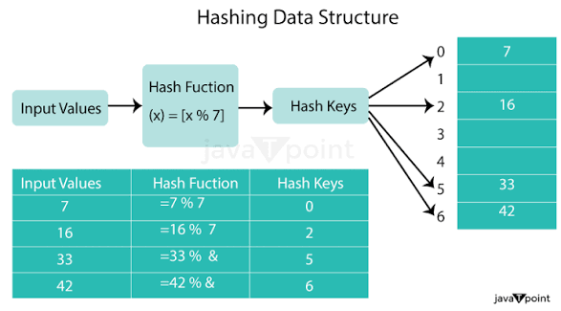
Hash function working

Slide 33
DIVISION METHOD:
The division method is a hashing technique where the hash value is calculated by taking a key and finding the remainder after dividing it by the size of the hash table (key modulo m).
This remainder serves as the index in the hash table for storing or retrieving the data.
The hash function H defined by
H(k)=k (mod m) or H(k)=k (mod m) + 1
Here k( mod m ) denotes the remainder when k is divided by m. The second formula is used when we want the hash addresses to range from 1 to m rather than from 0 to m-1.

Slide 34
DIVISION METHOD:
Example
We have keys :
12 34 43 52
Apply : H(k)=k (mod m) M-> size of table say 10
12 mod 10 =2
34 mod 10=4
43 mod=10=3
52 mode10=2 -→ collision occurs
12
43
34

Slide 35
MID SQUARE METHOD:
finds a hash address by squaring the key, taking the middle digits of the result, and then using these digits to determine the index in the hash table:
H(k²)=l
Where l is obtained by deleting digits from both ends of k². we emphasize that the same positions of k² must be used for all of the keys.

Slide 36
MID SQUARE METHOD:
H(k)=mid(k²)
Example key 12 , 123
(k²) =(12) = 144 →4
(k²) =(123) = 15129 →1
Complex when key size increases and chances of collison
123
12

Slide 37
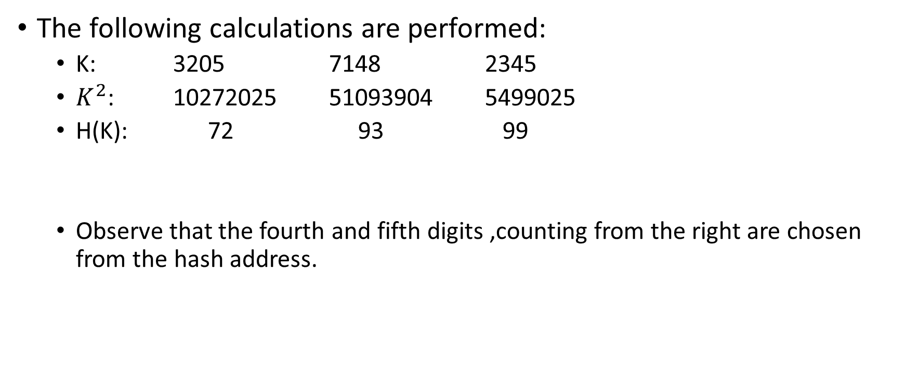
SOLUTION:MIDSQUARE METHIOD
The following calculations are performed:
  K: 3205 7148 2345
  $K^{2}$: 10272025 51093904 5499025
  H(K): 72 93 99
  Observe that the fourth and fifth digits ,counting from the right are chosen from the hash address.

Slide 38
FOLDING METHOD:
The key k is partitioned into a number of parts, k₁,…….kᵣ, where each part, except possibly the last, has the same number of digits as the required address. Then the parts are added together, ignoring the last carry. That is,
H(k)=k₁+k₂+………+kᵣ mod m
Where the leading digits carries, if any, are ignored. Sometimes, for extra “milling”, the even numbered parts, k₂,k₄,……, are each reserved before the addition.

Slide 39
FOLDING METHOD:
H(k)=k₁+k₂+………+kᵣ mod m
Example
We have key 1234
k1+k2
12+34 =46 mod 20 ->6
1234

Slide 40
SOLUTION: FOLDING METHOD:
  Chopping the key K into two parts and adding yields the following hash addresses:
  H(3205)= 32+05=37 hash address
  H(7148)= 71+48=119
  H(2345)= 23+54=77

Slide 41
COLLISION

Slide 42
COLLISION EXAMPLE:
Insert the sequence into Hash-Table :
Consider the following item.
18, 26, 35, 9, 64, 47, 96, 36, 70

Slide 43
COLLISION:
When an element is inserted, if it hashes to the same value as an already inserted element, then we have a collision .We have to resolve it
Collision resolving techniques:
Separate Chaining (A linked list based representation)
Open Addressing (Array based representation)
  Linear Probing, (Linear search)
  Quadratic Probing, (non linear search)
  Double Hashing

Slide 44
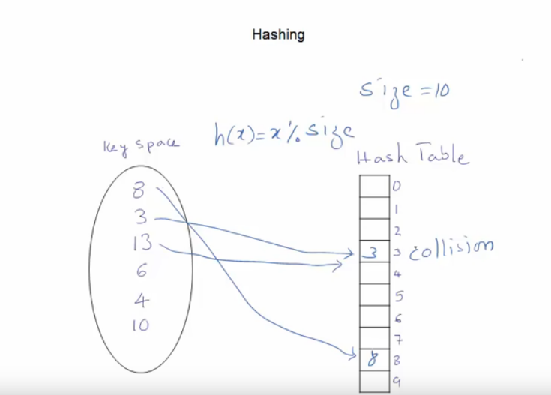
Collision f(x)=x%10 f(x)=8%10=8 f(x)=3%10=3 f(x)=13%10=3

Slide 45
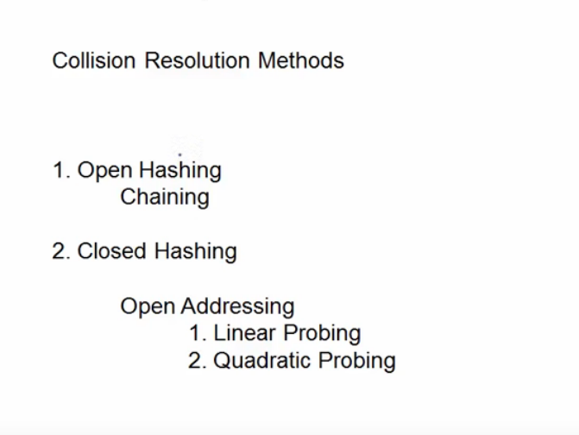
solution

Slide 46
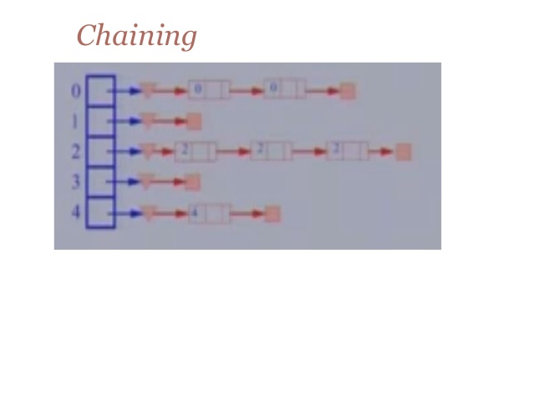

Slide 47
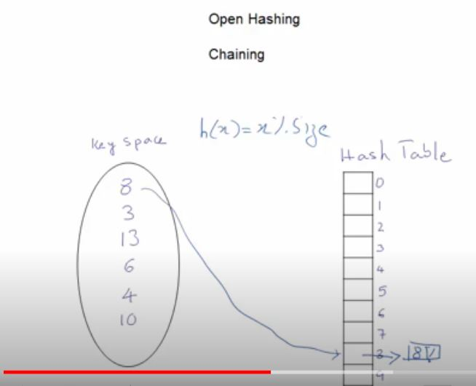
channing

Slide 48
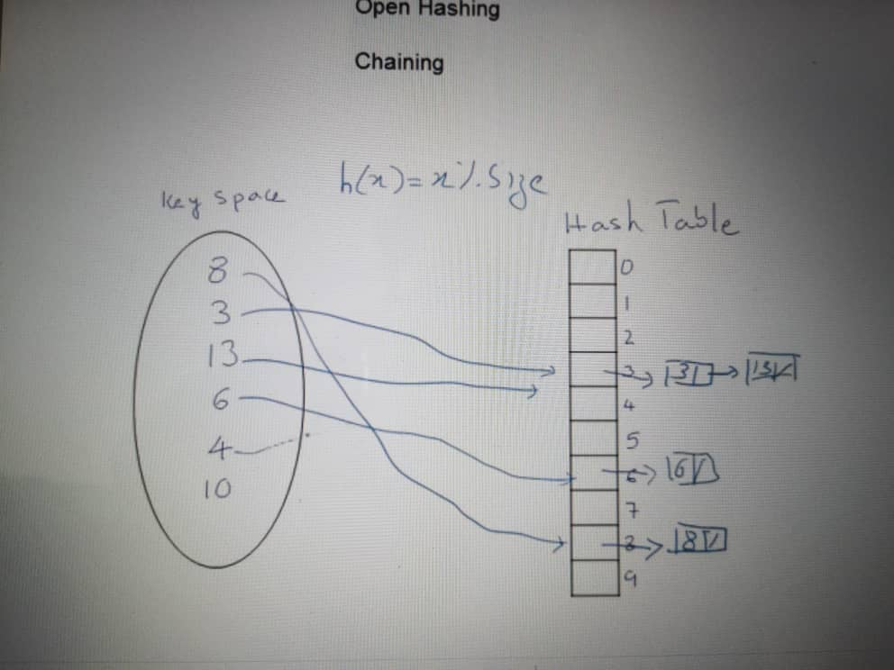
Chaning

Slide 49
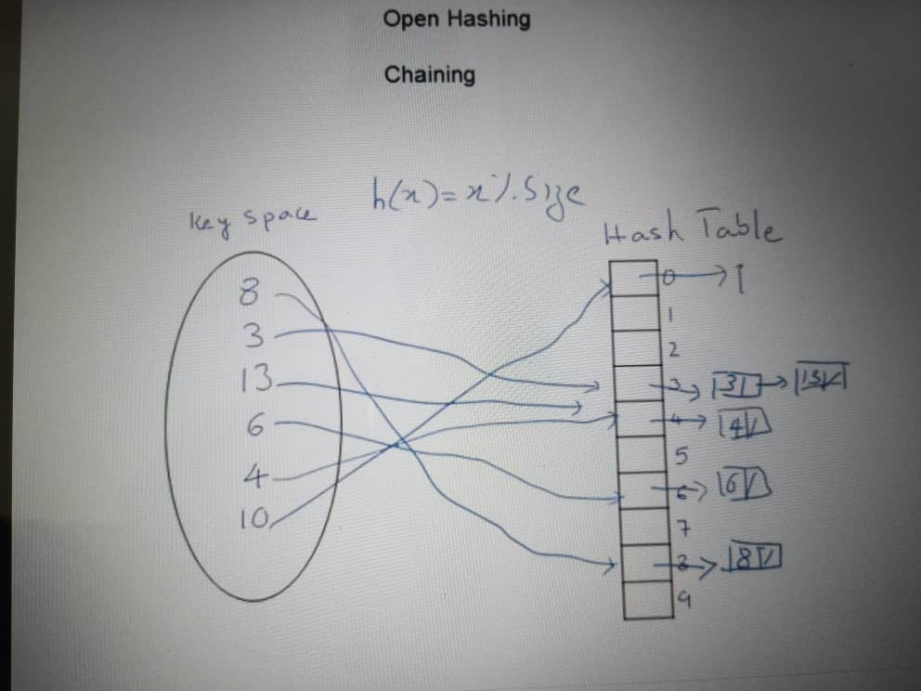
Chaning

Slide 50
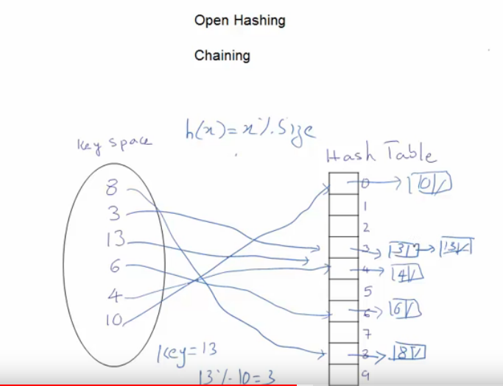
Search for a key

Slide 51
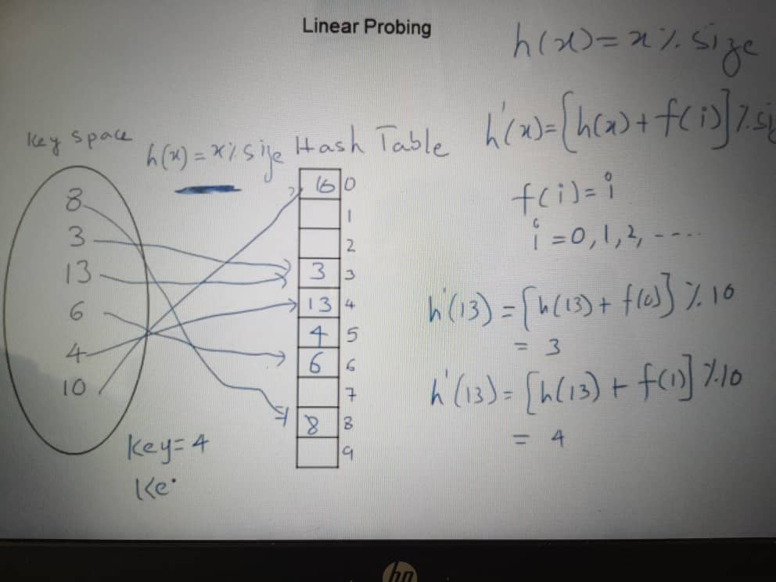
Linear probing

Slide 52
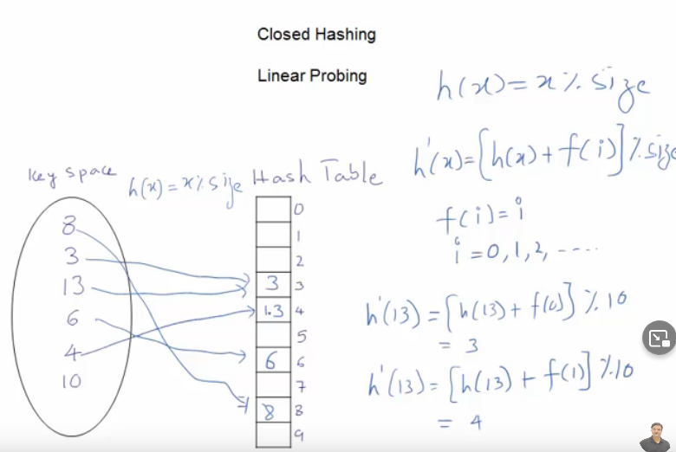
Again collision
When inserting 4, so we store at next position at 5

Slide 53
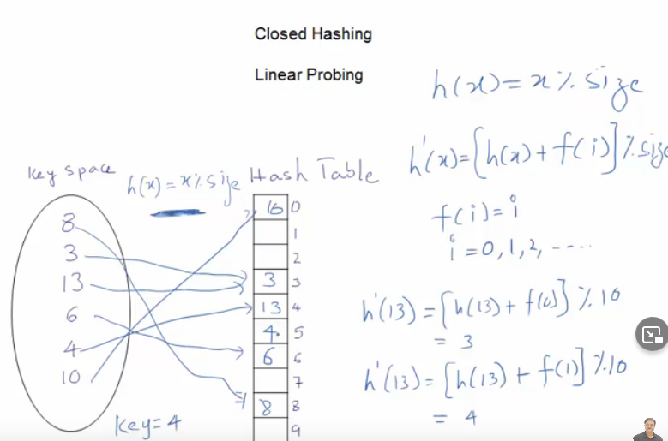
Searching element 4 we found at another location

Slide 54
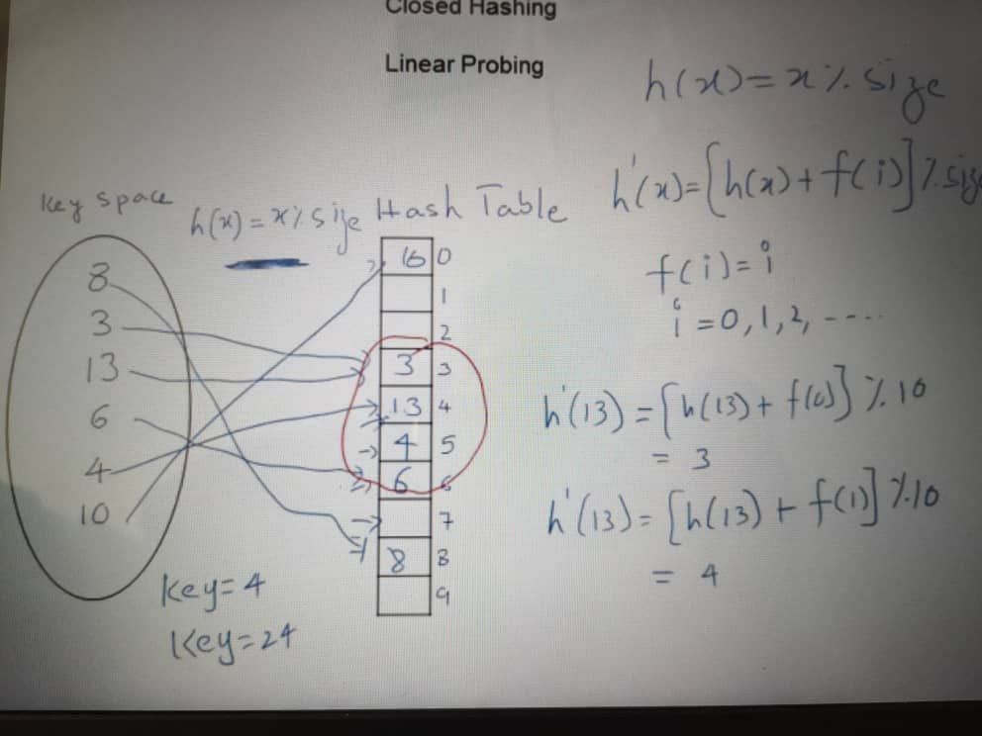
Linear probing

Slide 55
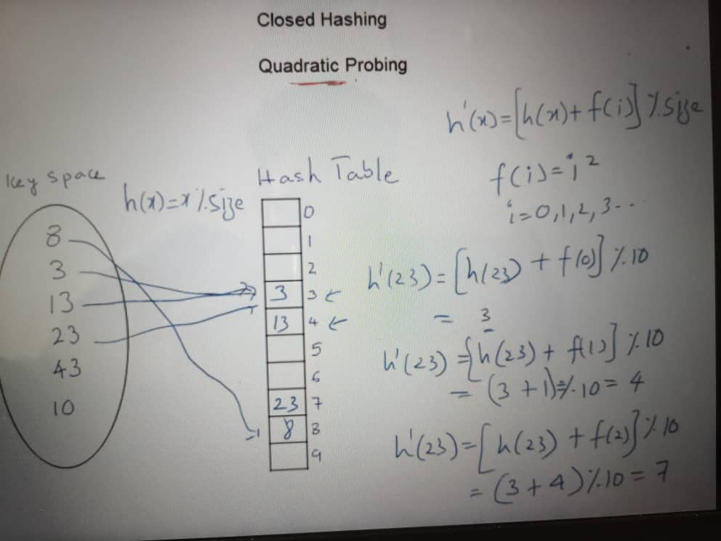
Quadratic probing

Slide 56
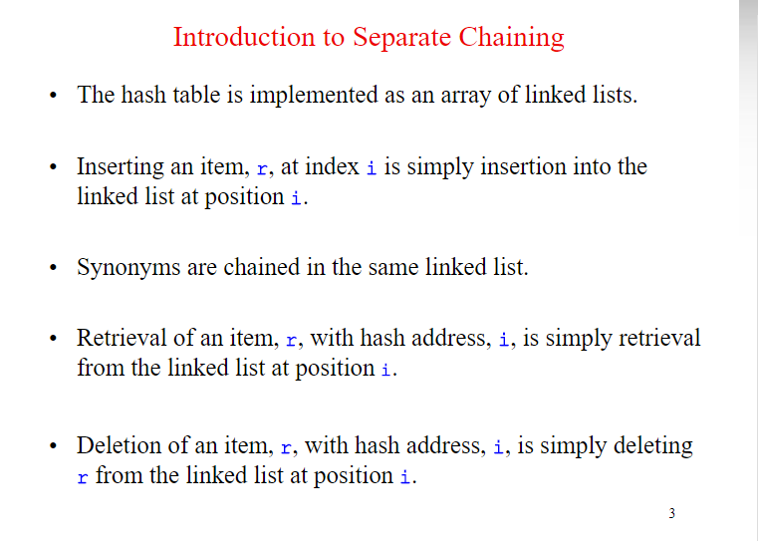

Slide 57
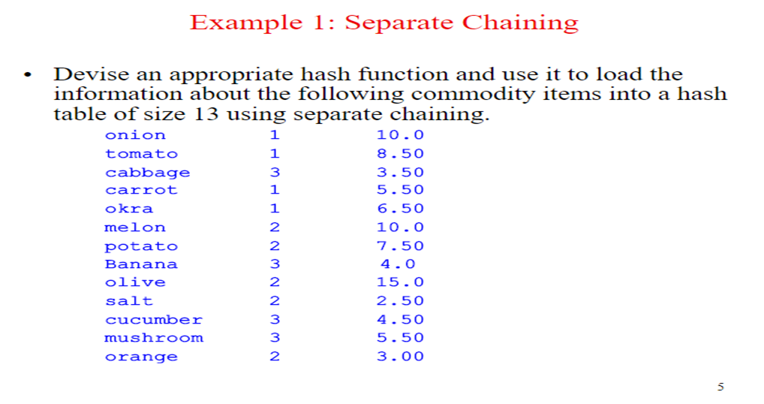

Slide 58
Open addressing:
Home area address are searched for an open or unoccupied element where now data can be occupied
2
New data
2

Slide 59
LINEAR PROBLING
    Resolve by adding ‘k’ to current address
  T(h) ,T(h+1),T(h+2)…
  Untill the data fiill

Slide 60
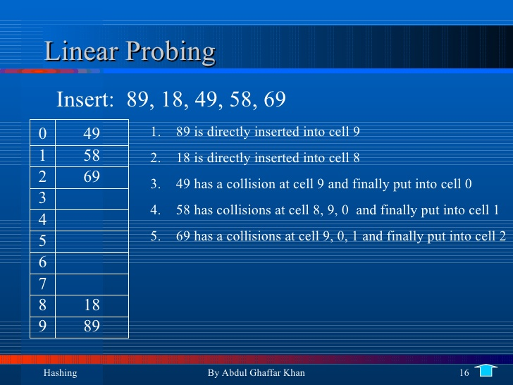

Slide 61
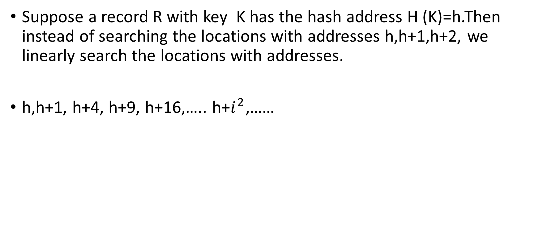
QUADRATIC PROBLING:
Suppose a record R with key K has the hash address H (K)=h.Then instead of searching the locations with addresses h,h+1,h+2, we linearly search the locations with addresses.
h,h+1, h+4, h+9, h+16,….. h+$i^{2}$,……

Slide 62
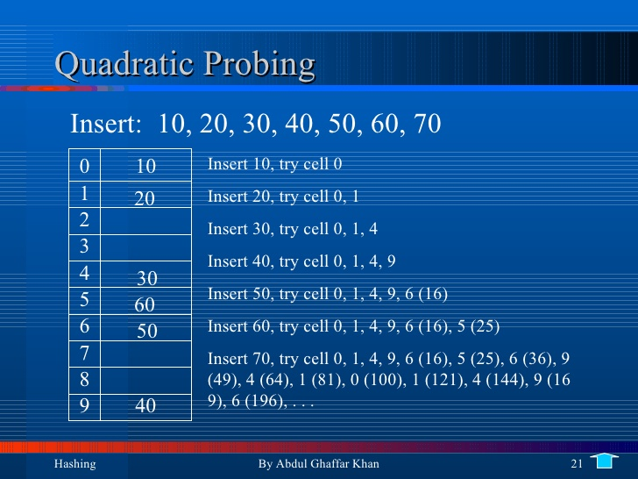
Wrong some mistake in this slide
Check yourself

Slide 63
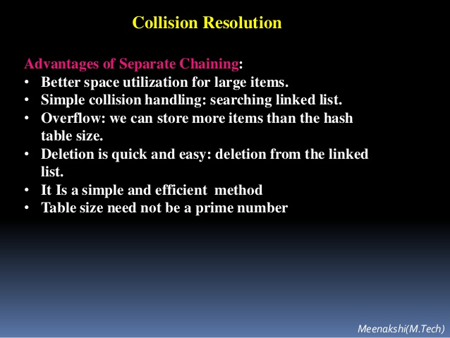

Slide 64
important
https://www.youtube.com/watch?v=mFY0J5W8Udk

Slide 65
DOUBLE HASHING:
Here is a second hash function H’ is used for resolving a collision as follows.
Suppose a record R with key K has the hash addresses H(K)=h and H’(K)=h’≠m. Then we linearly search the locations with addresses.
  H,h+h’,h+2h’,h+3h’,…..
  If m is the prime no,then the above sequence will access all the locations in the table T.

Slide 66
END LECTURE:

